Slide 1
Real Time Gender and Age Detection
Prem Kumar (RA2011033010057)
Ashish Prakash Singh (RA2011033010060)
Rimendra Agrawal (RA2011033010064)

Slide 2
Contribution -
Prem Kumar (RA2011033010057)- Project Idea , Presentation, Frontend
Ashish Prakash Singh(RA2011033010060)- Project Dataset, Frontend, Algorithm
Rimendra Kumar Agrawal(RA2011033010064)- Project Documentation, Algorithm

Slide 3
Problem Statement
AI has become a powerful tool for detecting gender and age from digital images. The problem statement is to develop an AI-based system that can accurately identify gender and age from digital Images or Video.
The system should be able to accurately identify gender and age from digital images or Videos, regardless of the environment or conditions in which the image was taken.

Slide 4
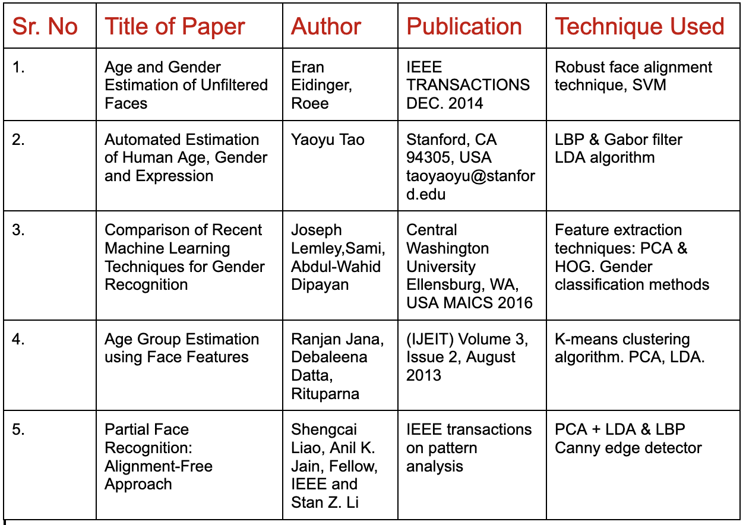
Literature Survey

Slide 5
Limitations
Biases and inaccuracies: AI systems can be biased due to the data they are trained on. If the training data is biased or not representative of the population, the system may not perform well on certain groups. For example, if the training data is mostly made up of images of white males, the system may not perform well on images of people with darker skin tones or females. From Paper (Age and gender Estimation of Unfiltered faces) we found it.
Lack of privacy: Facial recognition and other biometric data used for gender and age detection may raise privacy concerns, particularly if the data is used without consent or knowledge of the individuals involved. From Paper( Automated Estimation Human age) we found it.
Inability to account for fluidity: Gender and age are not always fixed concepts and can be fluid or change over time. AI systems may not be able to accurately account for this variability. From Paper (Partial Face recognition ) we found it.

Slide 6
Potential misuse: AI-based gender and age detection systems may be misused for
discriminatory purposes, such as targeting ads or denying based on age of gender.
Legal and ethical concerns: There are legal and ethical concerns surrounding the
used of AI-based gender and age detection systems, particularly if they are used
without the consent or knowledge of the individuals involved.

Slide 7
Objectives
Improving user experience: Age and gender detection can be used to personalize content and improve user experience. For example, an online shopping website can use age and gender information to recommend products that are more relevant to the user.
Enhancing security: Age and gender detection can be used in security systems to verify identities and prevent unauthorized access. For example, facial recognition technology can be used to match a person's face to their government-issued ID.
Targeted marketing: Age and gender detection can be used in marketing to target specific demographics with relevant advertisements. This can lead to higher conversion rates and a more efficient use of marketing resources.
Demographic analysis: Age and gender detection can be used to gather demographic data about a population. This can be useful for market research, public policy, and other applications where demographic data is important.

Slide 8
Proposed Methodology
Data Collection - Collect a diverse dataset of images or videos that includes individuals from different age groups, ethnicities, and genders.
Data pre-processing - Pre-process the data by resizing the images or videos to a fixed resolution, normalizing pixel values, and removing any background or noise.
Face detection: Detect and crop the face regions from the pre-processed images or videos using a face detection algorithm.
Face alignment: Align the detected face regions to a canonical pose using a face alignment algorithm.
Feature extraction: Extract features from the aligned face regions using a pre-trained deep neural network
Gender classification: Train a binary classifier to predict the gender of the individual using the extracted features.
Age estimation: Train a regression model to predict the age of the individual using the extracted features

Slide 9
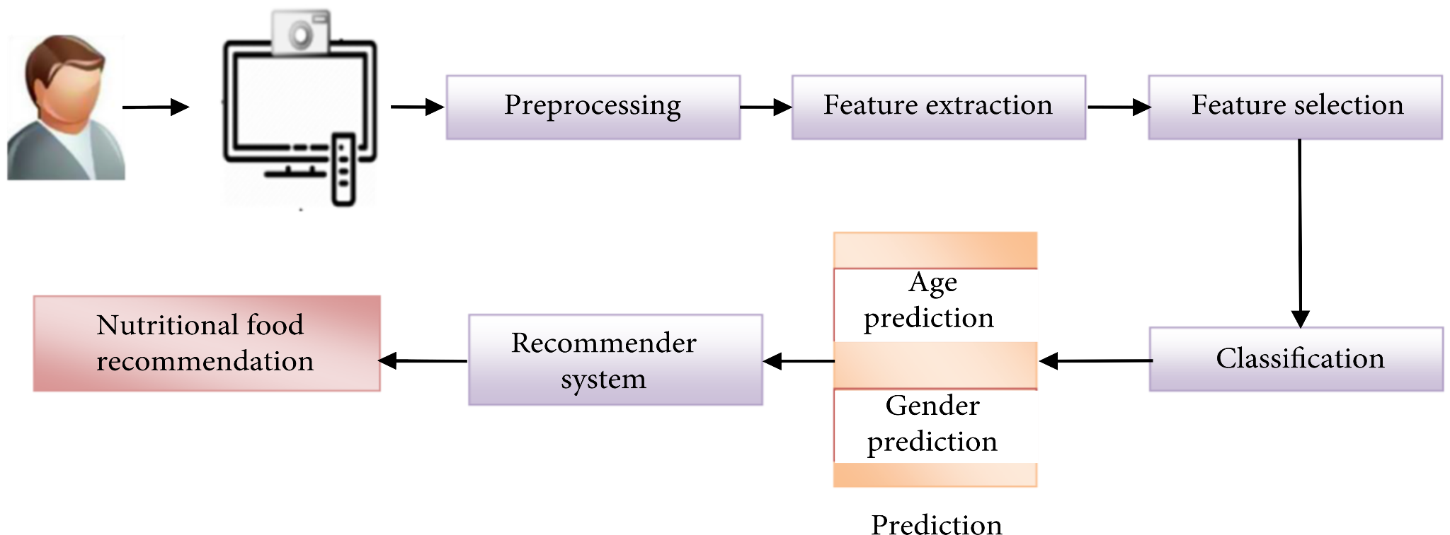
Architecture Diagram

Slide 10
Module with Explanations
Real-time gender and age detection is a computer vision technique that uses artificial intelligence and machine learning algorithms to recognize the gender and age of people in real-time video or image streams.
The system typically uses deep learning models that are trained on a large dataset of images to accurately identify gender and age based on facial features.
The gender detection module uses facial recognition algorithms to analyze various features such as the shape of the face, eyebrows, eyes, nose, and mouth to determine whether the person is male or female.
The age detection module involves extracting facial landmarks such as eye corners, nose tip, and mouth edges and using them to estimate the age of a person

Slide 11
This technique involves machine learning algorithms that have been trained on a large the real-time dataset of i images with known ages.
Gender and age detection module can be integrated into a wide range of applications, including security systems, marketing research, and human-computer interaction.
For example, it can be used to estimate the age and gender of shoppers in a store, allowing retailers to better tailor their marketing strategies to their customers' demographics.
Real-time gender and age detection is an exciting area of computer vision research that has many practical applications in various fields.

Slide 12
IMPLEMENTATION
Real-time age and gender detection can be implemented using various deep learning models such as Convolutional Neural Networks (CNNs) and pre-trained models like OpenCV. Here are the general steps to implement real-time age and gender detection:
Collect and prepare the data: You will need a dataset containing images of faces of different ages and genders to train the model. The images must be labeled with their corresponding age and gender.
Train a deep learning model: Use a pre-trained model or train a deep learning model from scratch using a deep learning framework like TensorFlow or PyTorch. A popular pre-trained model for age and gender detection is the OpenCV DNN face detector model.
Build an application: Build an application that captures real-time video from the camera, detects faces in the video frames, and applies the pre-trained age and gender detection model to each detected face.
Display the results: Display the detected age and gender information on the video feed, either as text or as an overlay on the video frames.

Slide 13
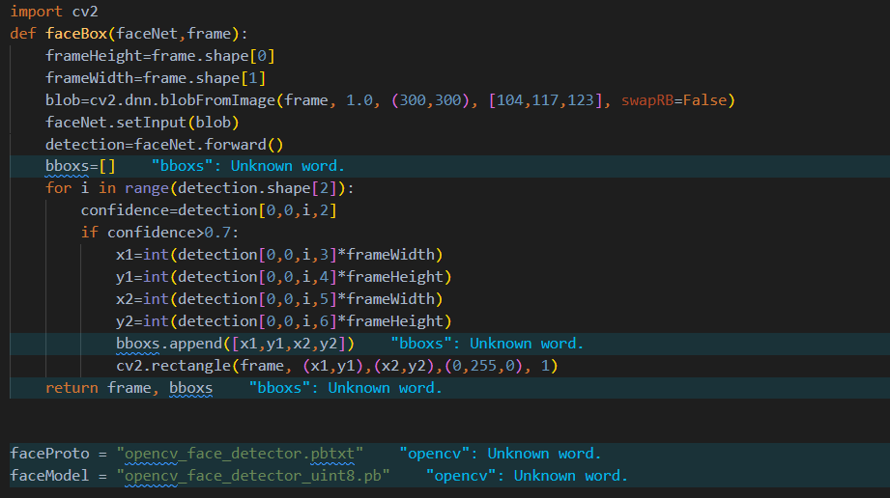
SCREENSHOT

Slide 14
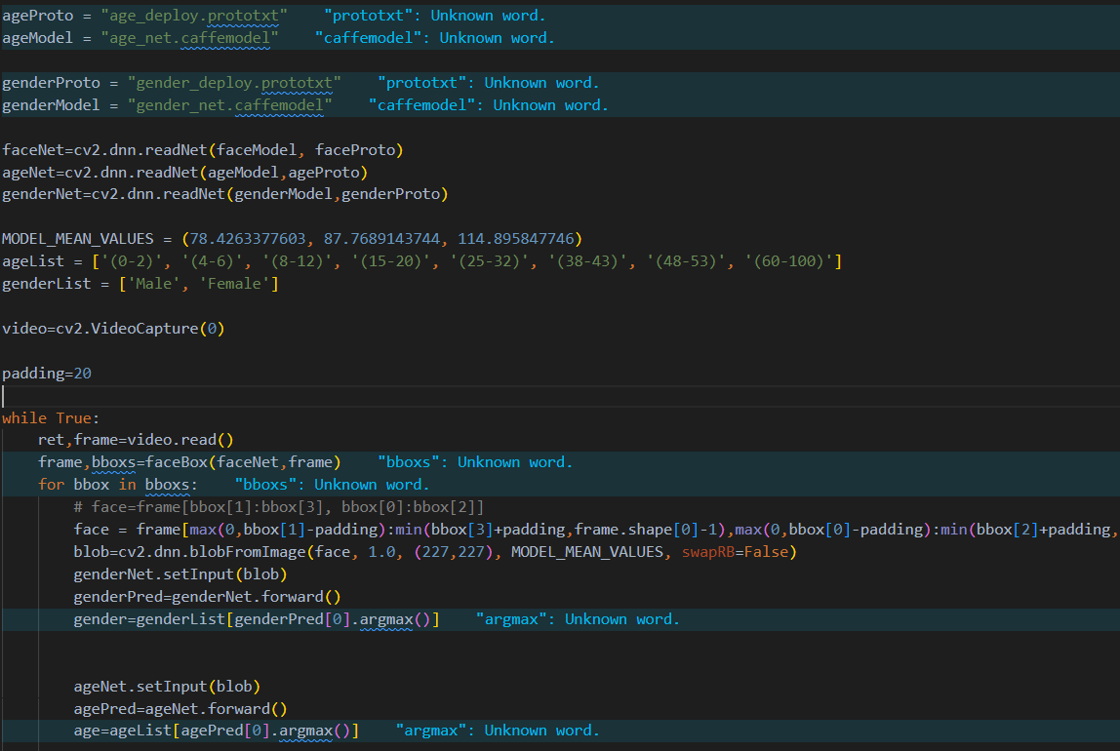

Slide 15
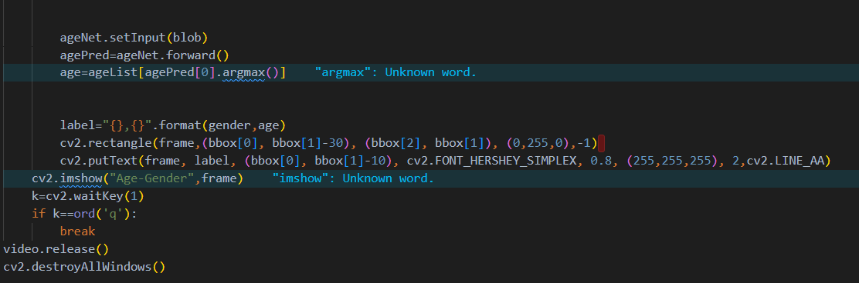

Slide 16
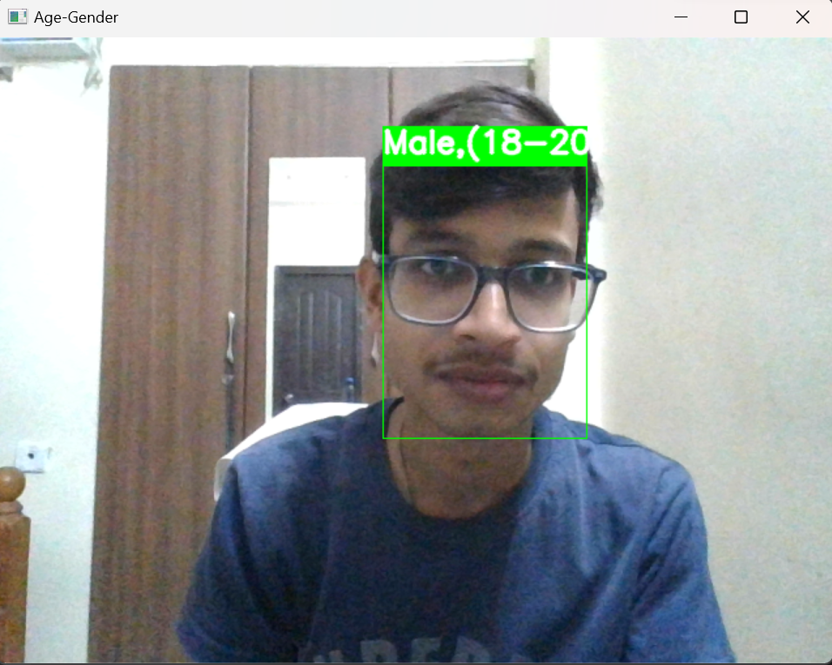
RESULTS

Slide 17
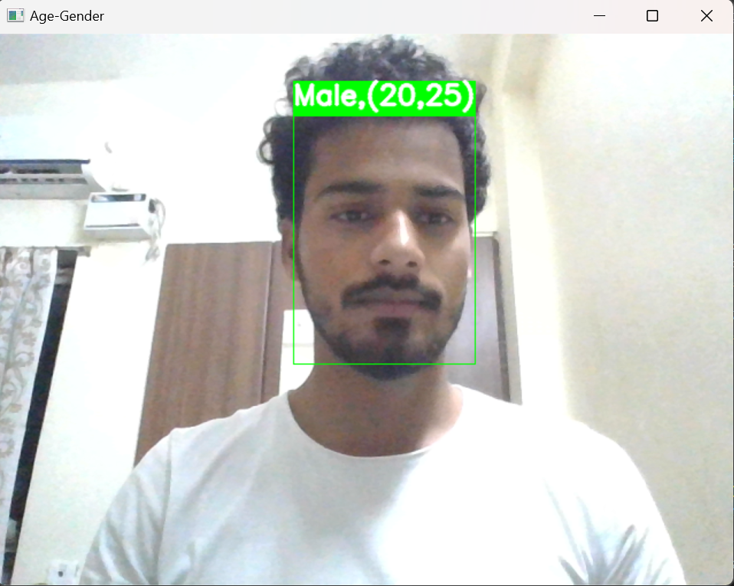

Slide 18
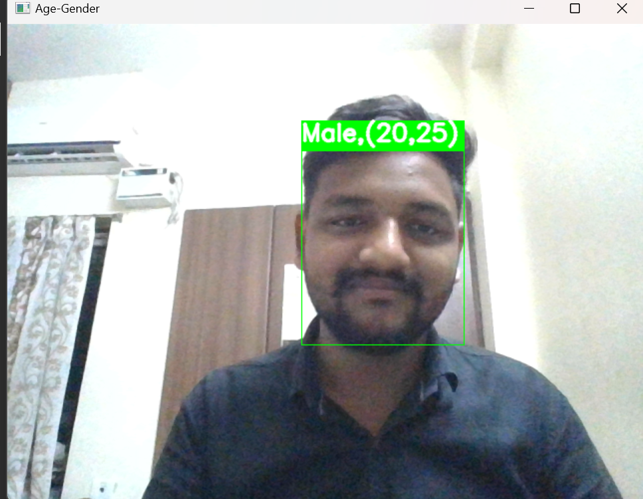

Slide 19
ANALYSIS
Real-time gender and face detection is a technology that allows for the identification of human faces and determination of their gender in real-time. It has various applications, including security systems, marketing, and user interface personalization.
The technology works by using computer vision algorithms to analyze images or videos captured by a camera or webcam. The algorithms identify and track facial features, such as the eyes, nose, and mouth, and use these features to detect the presence of a human face.
There are several methods used for real-time gender and face detection, including:
Haar Cascades: This is a machine learning-based approach that uses a set of pre-trained classifiers to detect facial features and identify gender.

Slide 20
Convolutional Neural Networks (CNN): This approach uses deep learning algorithms to analyze images and detect facial features, including gender.
Local Binary Patterns (LBP): This approach uses texture analysis to identify facial features and detect gender.
Real-time gender and face detection technology has the potential to be highly accurate, but it can also be affected by various factors, including lighting, camera angles, and occlusions. Additionally, the technology has raised concerns about privacy and ethics, as it could potentially be used for surveillance or other invasive purposes.

Slide 21
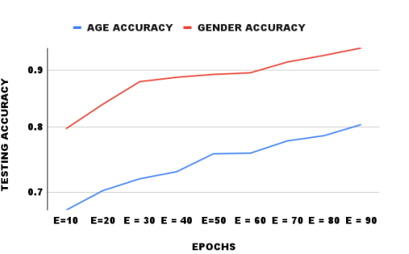

Slide 22
GITHUB LINK
https://github.com/hrprem16/RealTime-Age-and-Gender-Detection

Slide 23
Reference
https://data-flair.training/blogs/python-project-gender-age-detection/
https://www.irjet.net/archives/V9/i2/IRJET-V9I295.pdf
https://itsourcecode.com/free-projects/python-projects/gender-and-age-detection-opencv-python-with-source-code/

Slide 24
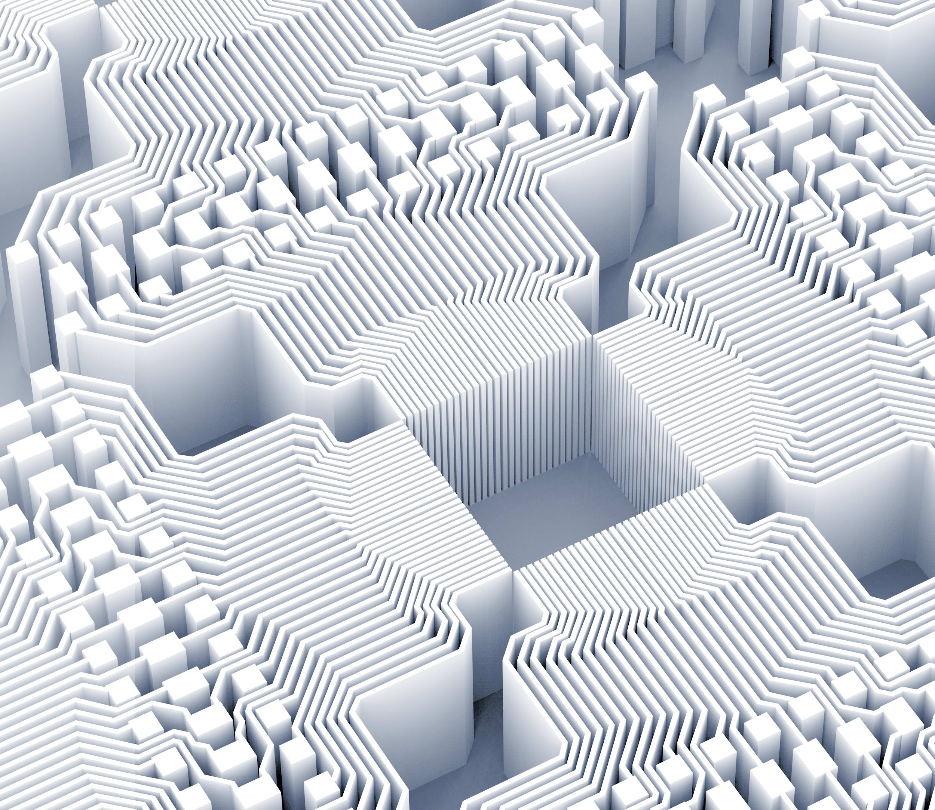
Thank you!
Prem Kumar (RA2011033010057)
Ashish Prakash Singh (RA2011033010060)
Rimendra Kumar Agrawal(RA2011033010064)

